Slide 1
Major Project Report on -
“Agricultural Crop Recommendations using Productivity And Season.
Guided By-
Prof.Bibhudhendhu Panda
(HOD, MCA Rims)

Slide 2
Index
Abstract
Introduction
Existing System
Disadvantage of Existing System
Proposed System
Advantages of Proposed System
System Architecture
Software and Hardware Requirement
Data Flow Diagram
UML Diagram
Algorithms used
Functioning
Output screenshots
Conclusion
References

Slide 3
Abstract
As a Coastal States faces uncertainty in agriculture which decreases its production, with more population and area , more productivity is expected but it cannot be achieved.
Growth of IT sectors drives some highlights in Agricultural Science to help farmers with good agricultural science to help farmers with good agri-information. Agricultural factors and parameters make the data to get insights about Agri-facts.
Machine Learning techniques develops a well-defined model with data and helps us to attain predictions. Agricultural issues like crop prediction, rotation, water requirement, fertilizers requirements and protection can be solved. Due to the variable climatic factors of the environment, there is a necessity to have a efficient technique to facilitate the crop cultivation and to lend a hand to the farmers in their production and management.

Slide 4
Introduction
India being the third largest area in Asia has 2nd largest population. It is the leading producer of agricultural product.
Agriculture is the main occupation of Indian people. Agriculture has a sound tone in the competitive world. Many Areas farming acts a major source of occupation.
Agriculture makes a dramatic impact in economy of the country, due to the change of natural factors, agriculture farming is degrading day by day.
Agriculture directly depends on the environmental factors such as sunlight, humidity, soil type, rainfall , maximum and minimum temperature, climate , fertilizers, pesticides, etc.
Knowledge of proper agriculture needs to bloom in Agriculture.

Slide 5
Existing System
Crop recommendation systems aim to improve agricultural productivity, enhance farmer livelihoods, and promote sustainable farming practices in India. They leverage technology, scientific research, and local agricultural expertise to provide timely and relevant information to farmers, helping them make better-informed decisions throughout the crop production cycle.
Due to the diversity of season and rainfall, assessment of suitable crop cultivation is necessary. Farmers face major problems such as crop management, expected crop yield and productive yield from crops. Farmers or cultivators need proper assignment regarding crop cultivation as nowadays many youngsters are interested in agriculture.

Slide 6
Disadvantages of Existing System
Prediction of crops was done according to farmer’s experience in the past years . Although farmer’s knowledge sustains, agricultural factors has changed to astonishing level.
Due to the diversity of season and rainfall, assessment of cultivate is necessary. Farmers face major problem such as crop management , expected crop yield and productive yield from the crop.
Farmers or cultivators need to proper assistance regarding crop cultivation as nowadays many fresh youngsters are interested in agriculture.
Data is increasing day by day in field of agriculture. With the advancement in Internet of Things, these are ways to grasp huge data in the field of Agriculture.

Slide 7
Proposed System
Our Proposed systems have lent its hands to users to choose items they like. Proposed system is the approach to provide the suggestion to the users of their interest. This can be practiced for agricultural use too.
Based upon the factors of agriculture , farmers are given with ideas for their cultivation can also be recommended. Pesticides, fertilizers can also be recommended. Hybrid Recommender system built by Agaji Iorshase to recommend agricultural projects solves issues like serendipity, ratio diffusion and ramp-up.
This system uses both collaborative and content-based filtering approach of recommender system. Dataset are collected for the food products of Benue State of Nigeria. Proposed method provides better quality.

Slide 8
Advantages of the Proposed System
The proposed system has the key role in applying mining, hidden useful knowledge is extracted as well as future prediction can be made. Data gained is classified; Associated and Clustered is aim to make farmers to choose between crops; acquire new farmers and correlate the crops.
Proposed system acts as a good engine to provide suitable items to users considering other factors.
Proposed System assists the farmers to choose crops for rotation and proper fertilizers.
Based on the soil analysis report, fertilizers have been recommended to farmers considering the Nitrogen,Sulphur , Phosphorus and Potash nutrients.

Slide 9
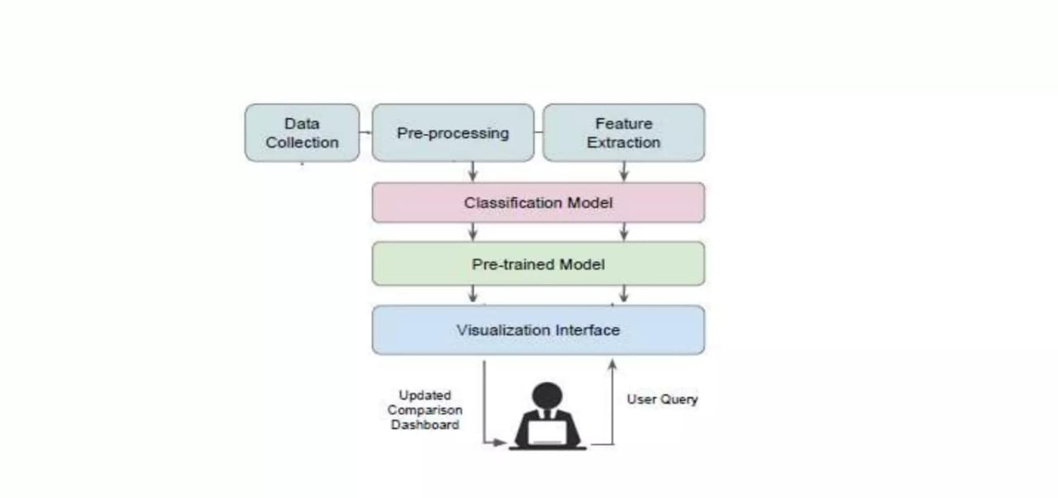
System Architecture

Slide 10
Software and Hardware Requirement
Software Requirement:
Operating System: Windows 10
Coding Language: Python
Web Framework: Flask
Hardware Requirement:
System: Pentium i3 processor
Hard Disk: 500 GB
Input Device: Keyboard , Mouse
RAM: 4 GB

Slide 11
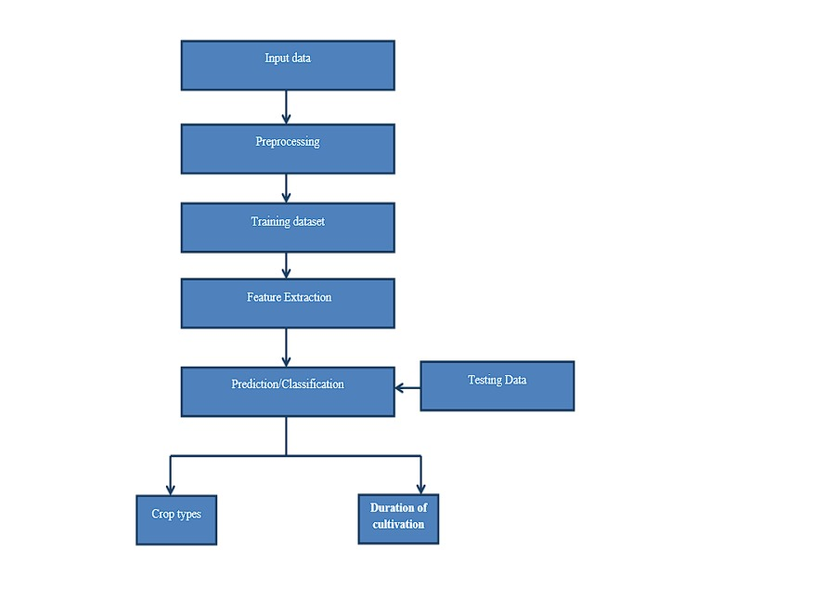
Data Flow Diagram

Slide 12
UML Diagram
Use Case Diagram
Class Diagram
Sequence Diagram
Activity Diagram

Slide 13
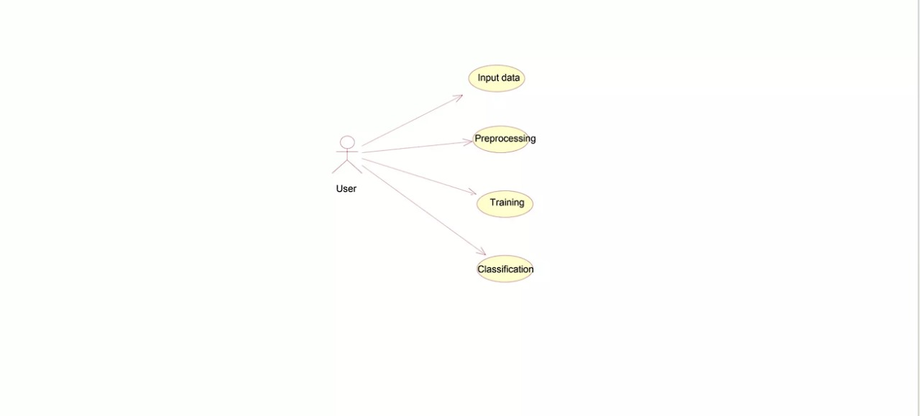
Use Case Diagram

Slide 14
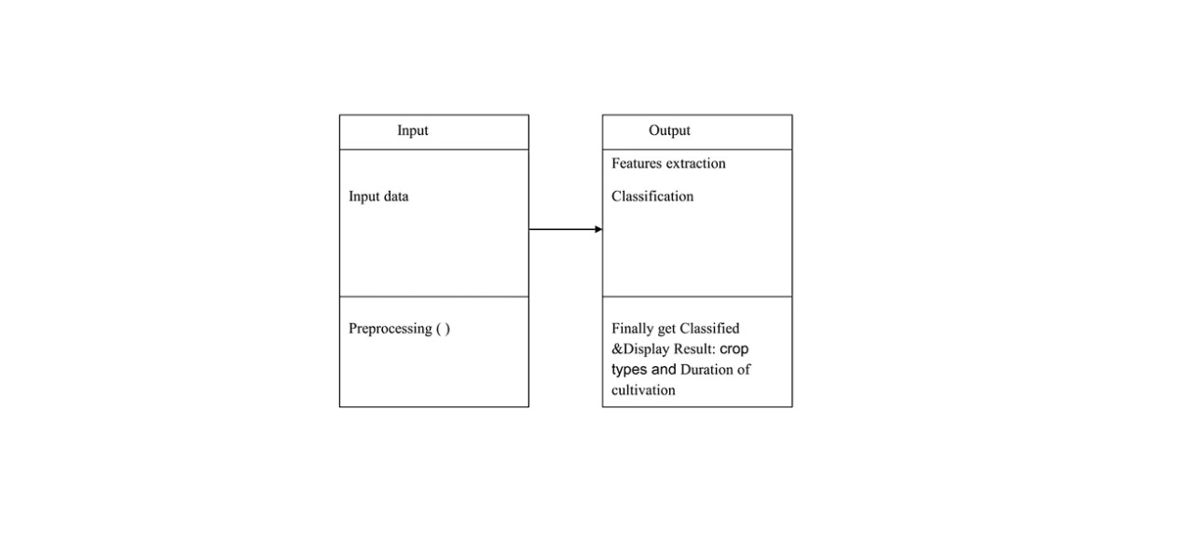
Class Diagram

Slide 15
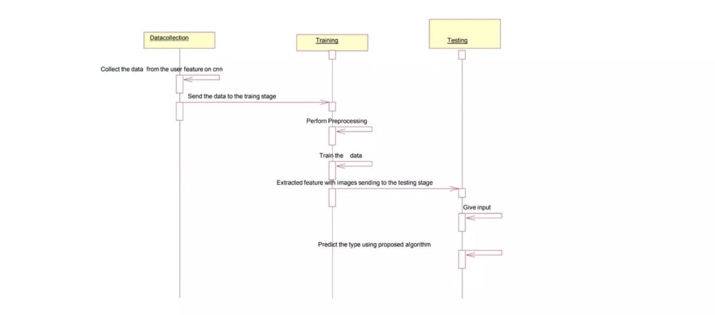
Sequence Diagram

Slide 16
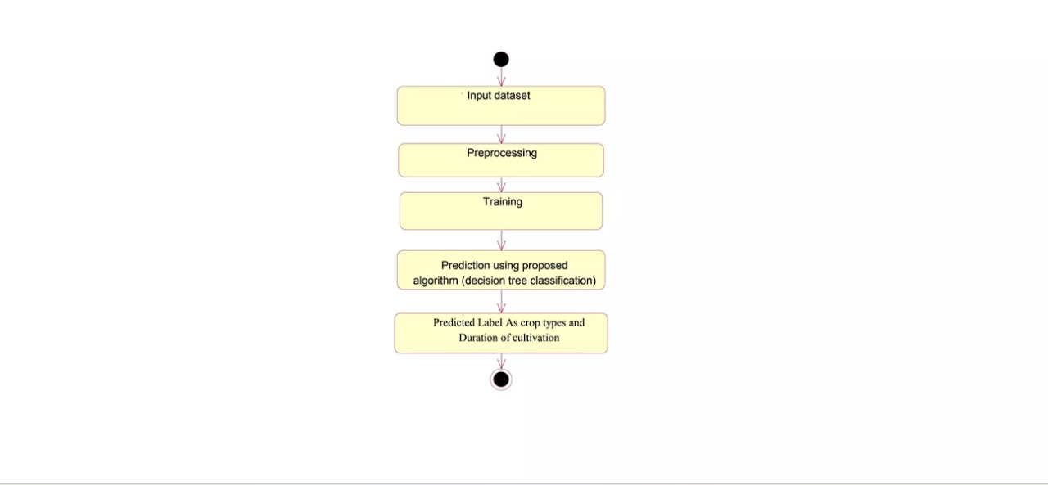
Activity Diagram

Slide 17
Algorithms Used
Random Forest Algorithm:
Random Forest is a classifier that contains a number of decision trees on various subsets of the given dataset and takes the average to improve the predictive accuracy of that dataset. Instead of relying on one decision tree, the random forest takes the prediction from each tree and based on the majority votes of predictions, and it predicts the final output. The greater number of trees in the forest leads to higher accuracy and prevents the problem of overfitting.
WHY USE RANDOM FOREST:
o It takes less training time as compared to other algorithms.
o It predicts output with high accuracy, even for the large dataset it runs efficiently.
o It can also maintain accuracy when a large proportion of data is missing.

Slide 18
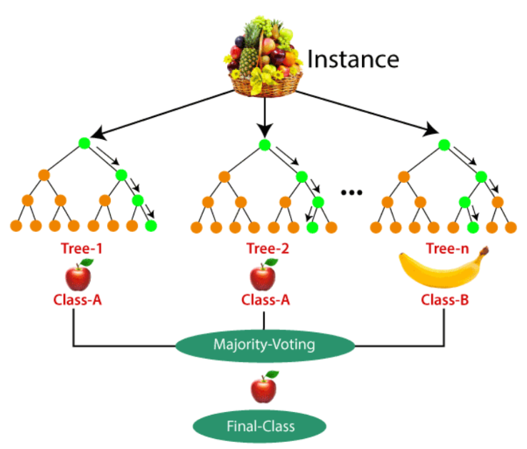
Working of Random Forest Algorithm:

Slide 19
XGBoost:
XGBoost is a robust machine-learning algorithm that can help you understand your data and make better decisions.
XGBoost is designed for speed, ease of use, and performance on large datasets. It does not require optimization of the parameters or tuning, which means that it can be used immediately after installation without any further configuration.
XgBoost is a gradient boosting algorithm for supervised learning. It's a highly efficient and scalable implementation of the boosting algorithm, with performance comparable to that of other state-of-the-art machine learning algorithms in most cases.
Why does XGBoost perform so well?
XGBoost and Gradient Boosting Machines (GBMs) are both ensemble tree methods that apply the principle of boosting weak learners (CARTs generally) using the gradient descent architecture. However, XGBoost improves upon the base GBM framework through systems optimization and algorithmic enhancements.

Slide 20
Support Vector Machine(SVM):
SVM is a powerful classification algorithm that can handle high-dimensional datasets with a relatively small number of observations, making it an ideal choice for crop recommendation systems.A crop recommendation system based on Support Vector Machines (SVM) is a machine learning algorithm that can predict which crops are best suited to a particular area based on various factors such as soil type, climate, and water availability.
SVC (Support Vector Classifier) is a type of machine learning algorithm that falls under the category of supervised learning. It is a variant of the Support Vector Machine (SVM) algorithm that is used for classification tasks. SVC works by finding the hyperplane that best separates the different classes in the data.
Crop recommendation systems based on machine learning techniques, such as Support Vector Machines, can help farmers and agricultural organizations make data-driven decisions about crop selection,maximize yields, and increase profits.

Slide 21
K-NN Algorithm:
The k-nearest neighbor (k-NN) method is a data mining technique considered to be among the top five techniques for data mining. In this, we consider each of the characteristics in our training set as a different dimension in some space, and take the value an observation has for this characteristic to be its coordinate in that dimension, so getting a set of points in space. We can then consider the similarity of two points to be the distance between them in this space under some appropriate metric. The way in which the algorithm decides which of the points from the training set are similar enough to be considered when choosing the class to predict for a new observation is to pick the k closest data points to the new observation, and to take the most common class among these. This is why it is called the k Nearest Neighbors algorithm.

Slide 22
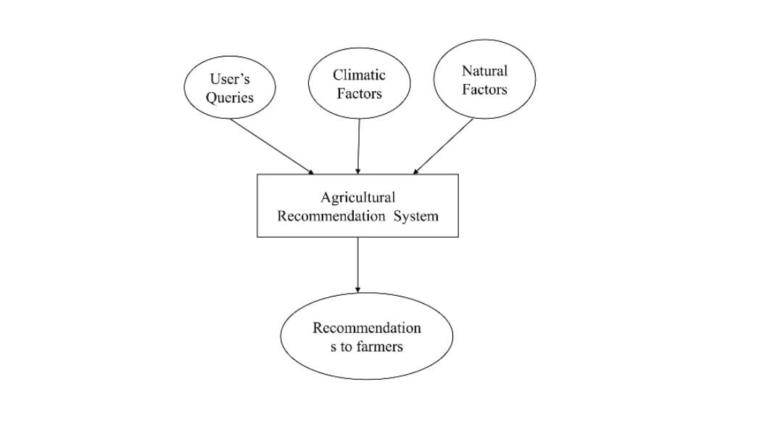
Functioning

Slide 23
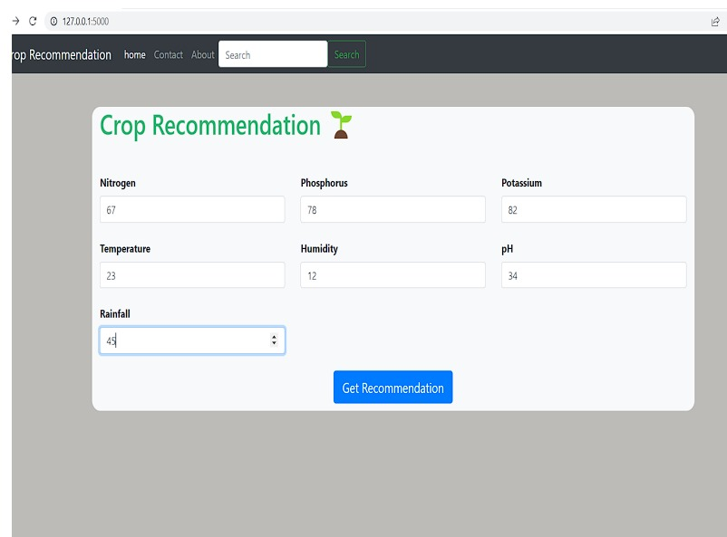
Output Screenshot 1
Here in above we have received the sensored details of Nitrogen, Phosphorus , Potassium minerals present in the observed area, as well as various other factors likes temperature and humidity of the atmosphere and pH level of the soil. Here also the data of rainfall is taken. Then after all the details, when we click on ‘Get Recommendation’ , then the Crop for the given land is suggested, that is shown on the next slide.

Slide 24
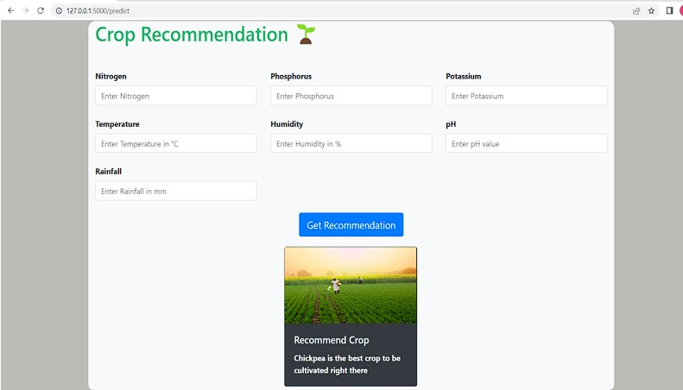
Output Screenshot 2
Here we will be getting the Recommended Crop as “Chickpea” as per the given data.

Slide 25
Conclusion
In this project, significance of management of crops was vastly studied. Farmers need assistance with recent technology to grow their crops. Proper prediction of crops can be informed to agriculturists in time basis. Many Machine Learning techniques have been used ro analyze the agriculture parameters.
The future development of crop recommendation systems is likely to involve advancements in technology, data analytics, and agricultural research to address existing challenges and improve the effectiveness of these systems.

